Slide 1
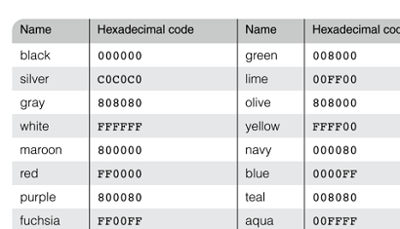
Color
The color property specifies the foreground color of elements
The background-color property specifies the background color of elements

Slide 2
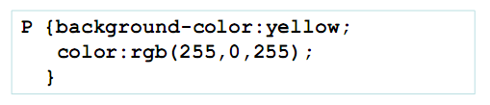

Color
Color name (e.g. black, gray, silver, white, red, lime, blue, yellow, aqua, fuchsia, maroon, green, navy, olive)
red/green/blue (RGB) values

Slide 3
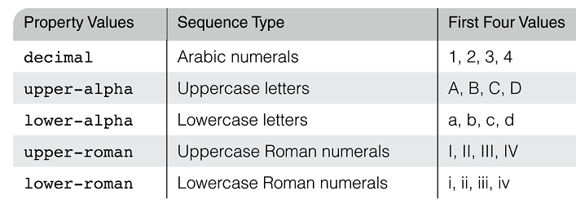
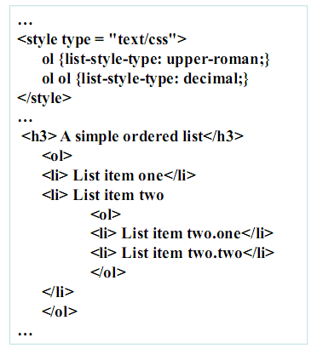
List Properties
On ordered lists - list-style-type can be used to change the sequence values

Slide 4

Text alignment
Text indent
Use the text-indent property, which takes a length of percentage value
Text alignment
Use the text-align property, which takes a keyword value from left, center, right and justify

Slide 5
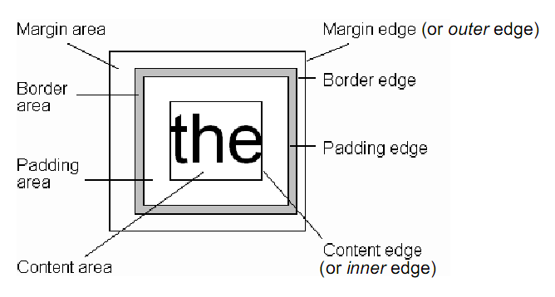
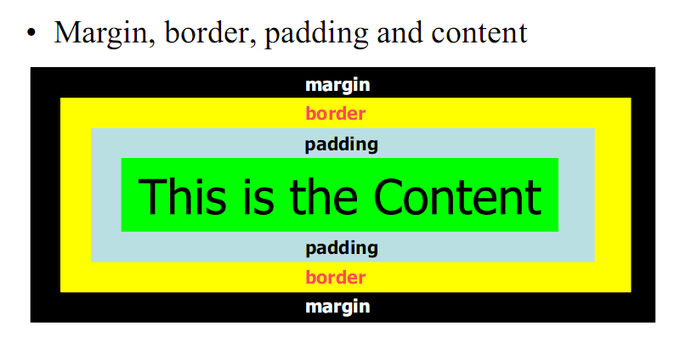
CSS Box Model
Every rendered element occupies a box:

Slide 6
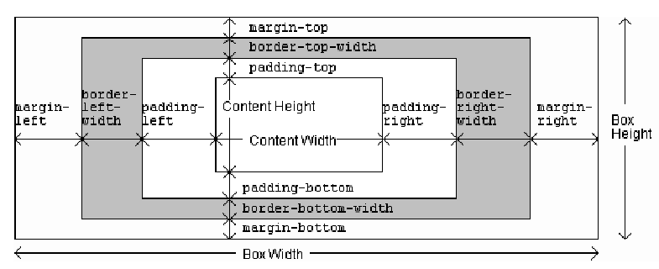
CSS Box Model length properties
There are 12 length properties in the CSS box model, corresponding the 12 distances between adjacent edges

Slide 7
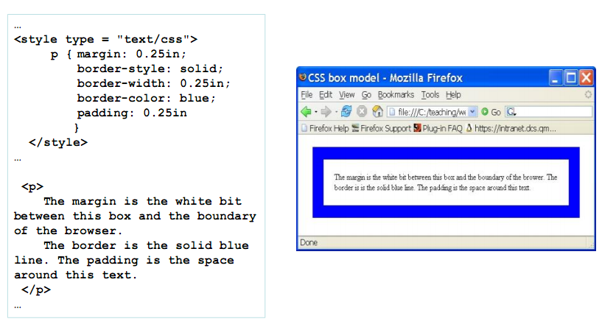
Box Model Example

Slide 8
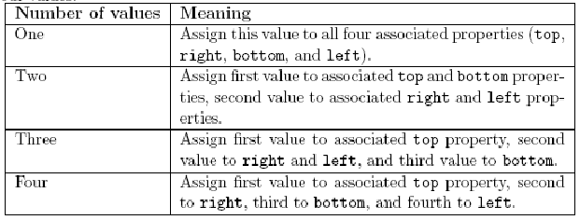
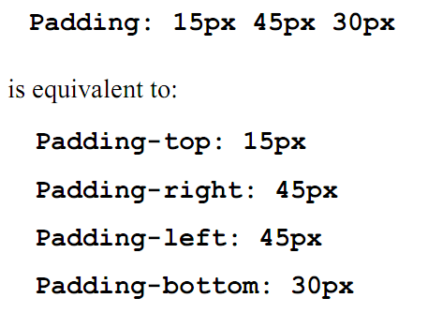
Shorthand properties

Slide 9
Backgrounds
background-color
– Specifies background color for content,
padding, and border areas
– Margin area is always transparent
– Not inherited; initial value transparent
background-image
– Specifies (using url() function) image that
will be tiled over an element

Slide 10
Background properties
The background image can be replicated using background-repeat property to fill the area of an element (values: repeat, no-repeat, repeat-x, repeat-y)
The position of an non-repeated background image is specified using the background-position property (values: top, center, bottom, left)

Slide 11
Beyond Normal Flow
Properties used to specify positioning:
position: static (initial value), relative, or absolute
float: none, left, or right

Slide 12
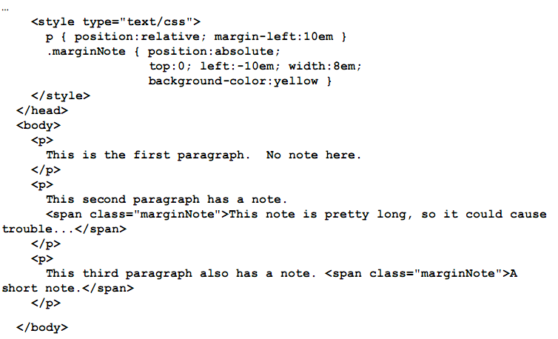
Absolute Positioning

Slide 13
Block & Inline elements
block-level elements are displayed with a line break before and after them
they form the larger structural components of a document
Block elements include
h1...h6,p,table,ol,ul,li,br,hr,pre,div (often used for formatting with stylesheets)
Inline elements
in-line elements are displayed in the current line
can generally only contain other in-line elements and text
span,a,code

Slide 14
Client Side Processing
client program (e.g. web browser) can be used to
customise interaction with the user
validate user input (although HTML5 now provides this)
generate (part of) document dynamically
this can be done using
programming language (e.g. Java applets)
XSL (for XML)
scripting language (e.g. JavaScript)
since these are built into browsers

Slide 15
Client-side scripting
scripts can be executed upon
loading a document
event occurrences
HTML <script> element specifies script to be executed
type attribute of <script> specifies language
src attribute of <script> specifies URI of external script
often <script> appears in the <head> and just declares functions to be called later
event attributes link scripts to events
event attributes in HTML include (18 in all)
OnLoad, OnUnload
OnClick, OnDblClick
onMouseDown, onMouseUp, onMouseOver, onMouseMove, onMouseOut
onKeyPress, onKeyDown, onKeyUp

Slide 16
JavaScript
interpreted, scripting language for the web
loosely typed
variables do not have to be declared
the same variable can store values of different types at different times
specified using the attribute and value type="text/javascript" in the <script> start tag
can generate HTML dynamically
can respond to user actions and input
can be used in client or server
syntax is a mixture of C and Java (and functional programming)

Slide 17
Document methods and properties
<script type="text/javascript"> document.write("<em>Document title</em>: ", document.title); </script>
document is a special object referring to the document displayed in the browser window
write is a method defined on an HTML document, which writes text into it
title is a property defined on document, which retrieves the title

Slide 18
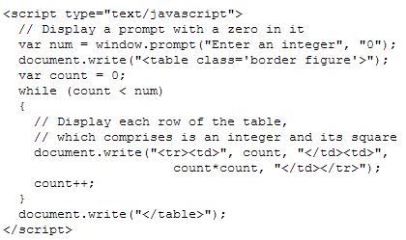
var declares a variable for storing values for later use
variables do not need to be declared before use, nor are they statically typed
a variable can be initialised with a value, e.g., count is set to zero
a JavaScript comment is indicated by //
prompt is a method of window, which opens a dialog box with the given message and default value for the input; it returns the value entered by the user
while is a loop which continues to execute its loop body (between { and }) until its condition (count < num) is false
count++ adds one to the value of the variable count, i.e., it is the same as count = count+1
JavaScript also provides the usual for loop construct

Slide 19
Events
more commonly, scripts are executed in response to events
the following button Click to see a message was produced using:
<button type="button" onClick="window.alert('Hello World!')"> Click to see a message </button>
onClick is an event
alert is a method of window, which opens a new window displaying the message given as argument
here the script is embedded in the value of the onClick attribute
more commonly, the value of the onClick would be a function call

Slide 20
Calling a function
<form> <label>Enter a word:</label>
<input type="text" name="word" />
<input type="button" value="Translate" onClick="this.form.result.value = myTranslate(this.form.word.value)" />
<input type="text" name="result" /> </form>
the form element indicates an HTML form
an HTML form is usually used for submitting information to a server, but not here
the onClick attribute value includes a call to the user-defined function myTranslate (defined on the next slide)
this refers to the input element in which it occurs
this.form returns a reference to the form in which the input element occurs
this.form.word and this.form.result refer to the named input elements of the form
value refers to the contents of the named input elements

Slide 21
Defining a function
function myTranslate is defined in the external file client.js
this file is referenced in the head of this document as follows:
<script src="client.js" />
function myTranslate is defined as follows:
function myTranslate(word) { if (word === "hello")
return("buongiorno");
else if (word === "goodbye")
return("arrivederci");
else
return("unknown");
}
word contains the word the user entered
JavaScript has two equality operators: == and ===
== tests if two values are equal
=== tests if both the types and values are equal, so is considered safer
e.g., (1 == true) is true, while (1 === true) is false

Slide 22
An alternative solution
each element in HTML can have an id attribute whose value is supposed to be unique
this is often used in combination with stylesheets and scripts
if the form used id attributes as follows:
<form> <label>Enter a word:</label>
<input type="text" name="word" id="myWord" />
<input type="button" value="Translate" onClick="myResult.value=myTranslate(myWord.value)" />
<input type="text" name="result" id="myResult" />
</form>
we could use myResult and myWord instead of this.form.result and this.form.word, respectively

Slide 23
Anonymous function
we could use an anonymous function instead:
<input type="button" value="Translate" onClick="result.value=function (w) {
if (w === 'hello') return('buongiorno');
else if (w === 'goodbye') return('arrivederci'); else return('unknown'); }(word.value)" />
an anonymous function taking one parameter w is defined
and immediately invoked with argument word.value
we could even do away with the function by using the ternary ? operator:
result.value = (word.value==='hello') ? 'buongiorno' : ((word.value==='goodbye') ? 'arrivederci' :'unknown')

